Slide 1
Experiment Four
Measurement of the temperature by the constant volume gas thermometer
(a)The room temperature.
(b)The boiling point of liquid

Slide 2
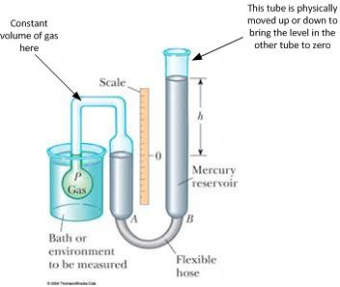
Apparatus:
Constant volume air thermometer as shown in figure (1)
Figure (1): Constant volume air thermometer

Slide 3
PROCEDURE:
If the apparatus is not furnished with a suitable device to indicate the volume which is kept constant, fix a piece of (graph) paper to the apparatus, with a horizontal line PQ drawn on it coinciding with a convenient marking on the vertical scale.
Calibration by fixed points
Surround the bulb by finely crushed ice in a large funnel and, after leaving to stand until there is no future movement of the mercury, adjust the mercury meniscus in the left – hand limb of the manometer to the constant volume mark P. Read both the mercury levels, using a set –square or some other device for eliminating parallax errors in the reading.
Read the barometric height B.
As the other fixed point is, for all gas thermometers, the absolute zero (0 K), the thermometer is now calibrated and ready for use.
Measurement of the room temperature
Remove the ice bath, dry the bulb of the air thermometer, and allow the apparatus plenty of time to assume the temperature of the room. When there is no further movement of the mercury . adjust to the constant volume mark and read both mercury levels.
Measurement of boiling point.
Immerse the bulb in a boiling liquid ( water will suffice because its boiling point for the purpose of the experiment may be regarded as known ) and when the movement of the mercury has cased adjust to the constant volume marker and record both mercury levels.

